Slide 1
Biomedical NLP in Practice
Matthew Engelhard
Notes:
So far we’ve talked about bag of words
Quite powerful
Let’s take a look at what people are actually using

Slide 2
Bag of Words
…is common and effective for biomedical NLP

Slide 3
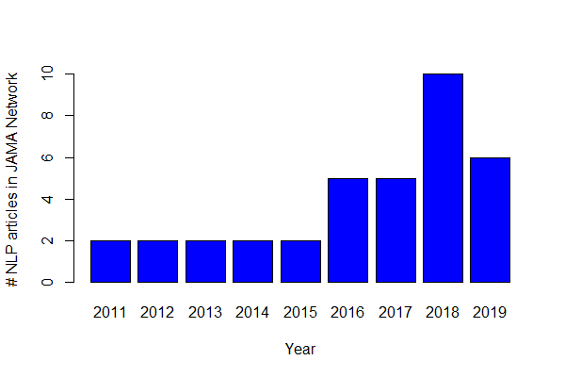
A Survey of NLP in JAMA…
Notes:
Articles in JAMA that mention NLP as of mid-2019

Slide 4
A Survey of NLP in JAMA…
1 uses word vectors
28 research
articles
28 use word counts or frequencies
The majority of these search only for a limited number of keywords or expressions
Notes:
Originally looked like 38 research articles
28 are doing NLP – the remaining 10 are talking about NLP in limitations, etc
Of these 28, only 1 using neural word embeddings (word2vec)
Of the remaining ones, most are looking for pre-specified keywords
Others are using a bag of words approach like we saw

Slide 5
A Survey of NLP in JAMA…
4 utilize EHR text features in predictive models (e.g. mortality)
28 research
articles
20 identify specific diagnoses or medical events from the EHR
4 identify other care-related information in the EHR
0 interpret words
in context
Notes:
Highlight the different topics
As of 2019, most articles were not interpreting words in context. And this is where the major opportunity lies… and has facilitated question answering, text generation, etc

Slide 6
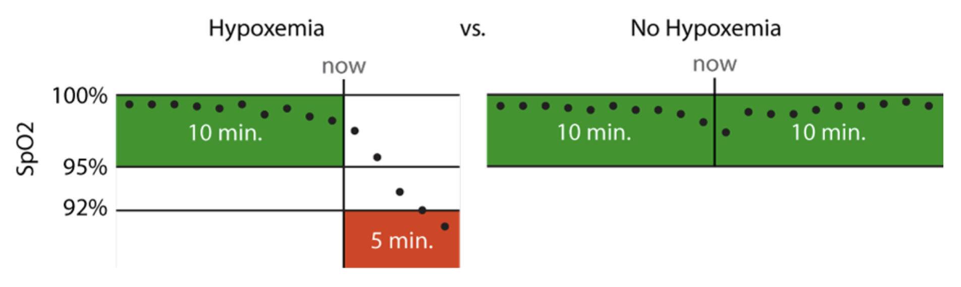
Hypoxemia Prediction during Surgery
Real-time Prediction Task:
hypoxemia (yes/no) in the next 5 minutes
based on data from the Anesthesia Information Management System
static features + real-time features collected up to that time point
Notes:
5 min window: long enough to allow an anaesthesiologist to intervene, but short enough to represent near-term risks that would benefit from immediate attention
This is actually what’s used for the anesthesiologist comparison
Model training was less strict

Slide 7
A majority of features are keyword counts
Notes:
Real-time information from Anesthesia Information Management System (Aims)
But we’re also using “NLP”…
Meaning, presence of specific words in notes

Slide 8
Global Maternal Health
Maternal Health HelpDesk:
2 million women connected to NDoH staff via SMS
https://www.praekelt.org
Binary Classification: Urgent Message? (Yes/No)
Notes:
In our example, bag of words was used to great effect
Triage based on bag of words
Identification of mistreatment of women based on keyword search, which we then refined. If you were doing this today, you could use word vectors… describe how this would work

Slide 9
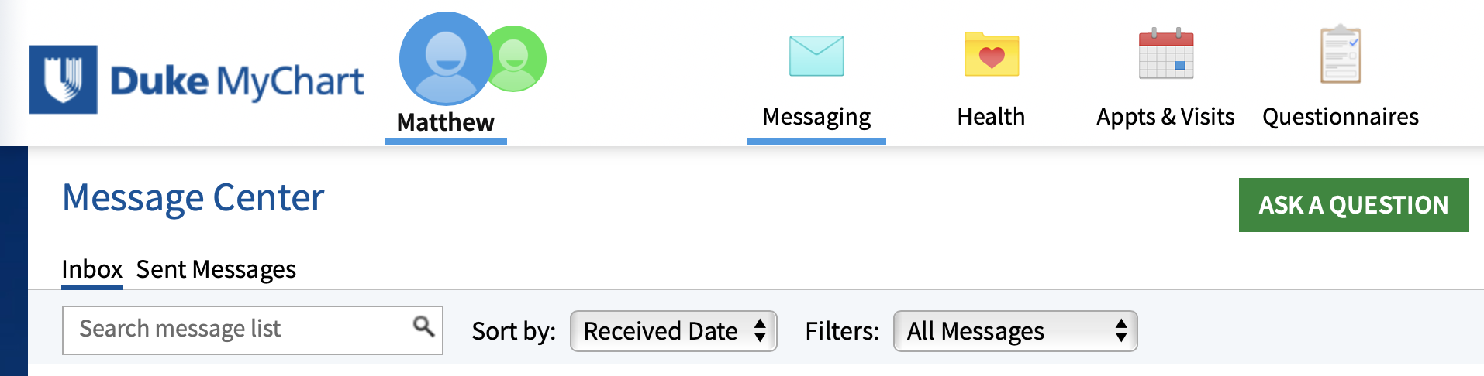
Suggested Email Responses
Notes:
We’ve talked about this example
So far, what’s been done is to triage messages very similar to previous
Use bag of words to do this

Slide 10
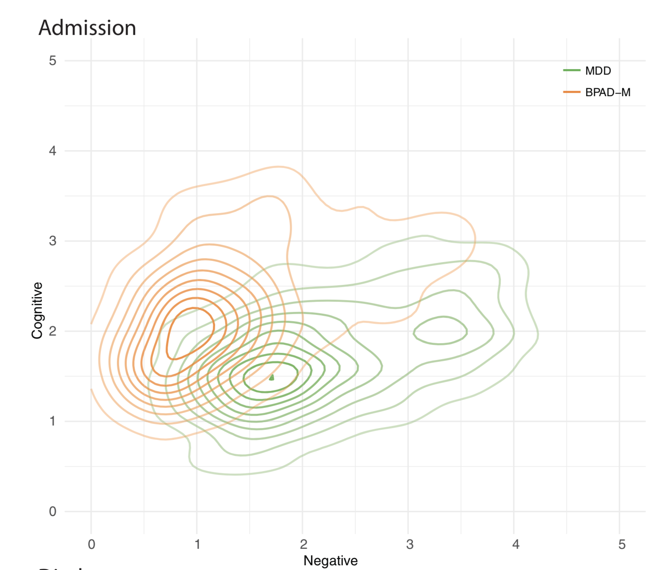
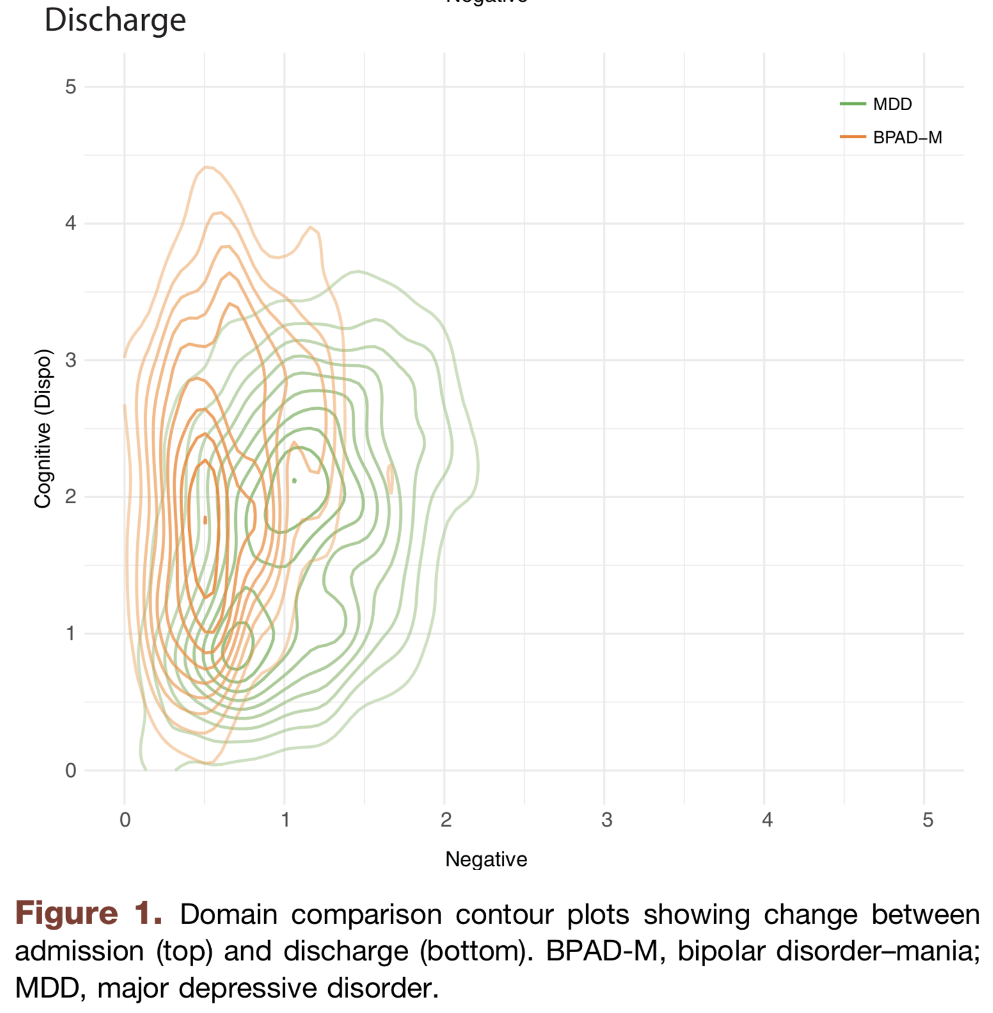
Trends in psychopathology during stay
McCoy Jr, Thomas H., et al. "High throughput phenotyping for dimensional psychopathology in electronic health records." Biological psychiatry 83.12 (2018): 997-1004.
Notes:
‘negative valence’ – words indicating anger, fear, etc
‘positive valence’ – words conveying happiness, joy, etc
The idea – have an automated method for identifying severity of dimensions of psychopathology
Then, use their score to look at descriptive statistics – i.e. admission / discharge trends and changes -- based on different psych dimensions

Slide 11
Scoring Dimensional Psychopathology
Expert-generated terms for each dimension
(e.g. angry)
Final list of terms for each dimension
+
Similar terms
from DSM-IV
(e.g. hostility)
Filter by association in clinical notes
McCoy Jr, Thomas H., et al. "High throughput phenotyping for dimensional psychopathology in electronic health records." Biological psychiatry 83.12 (2018): 997-1004.
Notes:
Much like I described for maternal health message triage
Here, we have expert-defined keywords, which we can then expand upon using word vectors

Slide 12
Deep Learning
…is on the rise for biomedical NLP

Slide 13
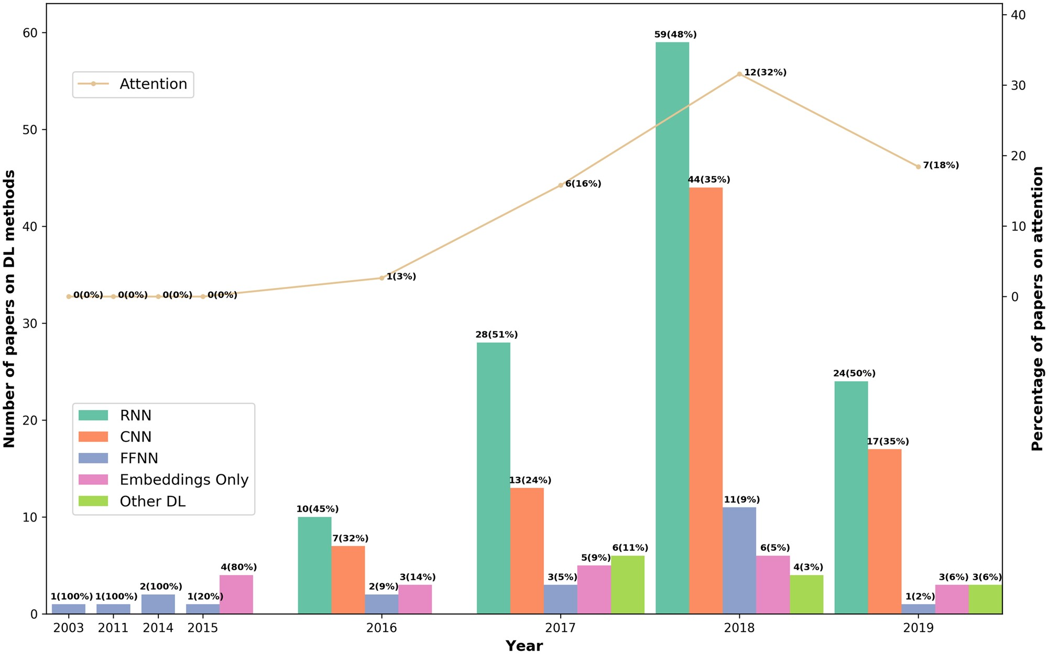
Rise of Deep Learning NLP in the Clinical Literature
J Am Med Inform Assoc, Volume 27, Issue 3, March 2020, Pages 457–470, https://doi.org/10.1093/jamia/ocz200

Slide 14
“Embeddings Only” and feedforward neural network (i.e. MLP) Simple Word Embedding Model
This is a sentence
max
MAX
Notes:
Lots of ways to use embeddings – e.g. relationships
But we can also build a simple model based on embeddings.
We’ll talk about this more in subsequent lectures

Slide 15
RNN: transfer relevant information about earlier words
This movie is awful
h_{i1}
h_{i2}
h_{i3}
MLP
MLP
MLP
MLP
esta pelicula es horrible
y_{i1}
y_{i2}
y_{i3}
y_{i4}
Notes:
Again… more in this in subsequent lectures

Slide 16
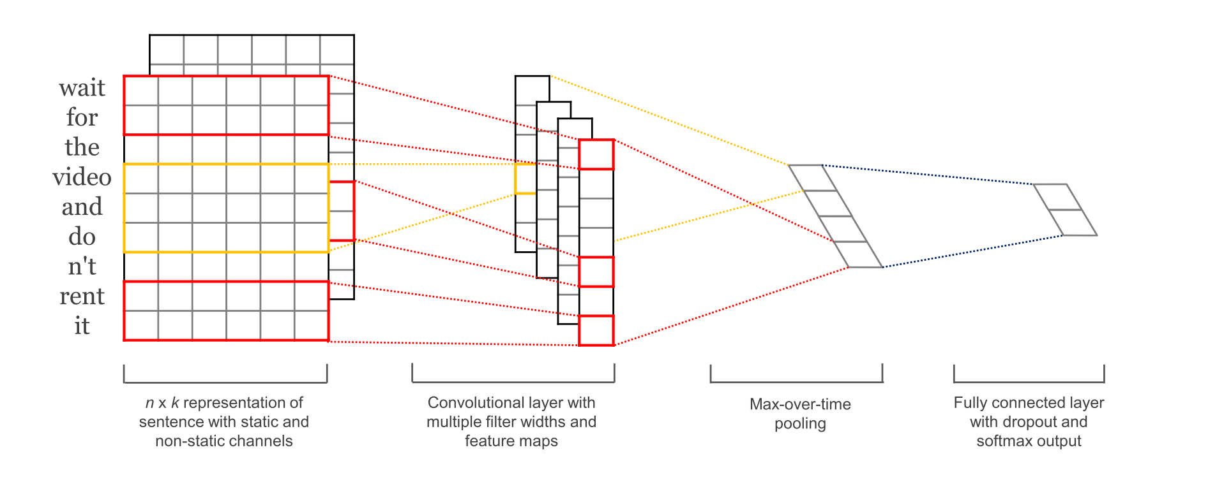
CNNs for NLP
Kim, Y. (2014). Convolutional Neural Networks for Sentence Classification

Slide 17
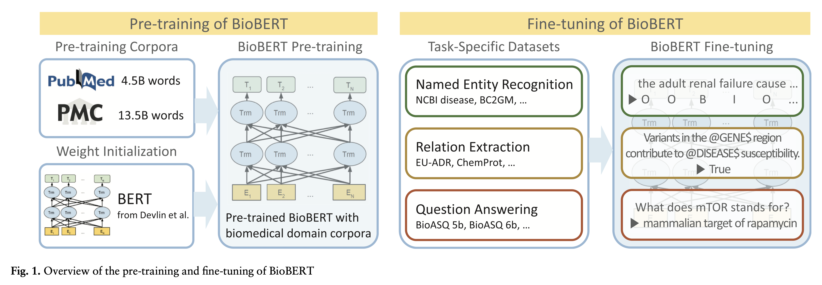
SOTA in 2021: re-purpose deep, pre-trained NLP models.
Lee J, Yoon W, Kim S, Kim D, Kim S, So CH, Kang J. BioBERT: a pre-trained biomedical language representation model for biomedical text mining. Bioinformatics. 2020 Feb 15;36(4):1234-40.
Notes:
Lots of libraries out there for this
Huggingface

Slide 18
Named Entity Recognition + Simple Models
…is often the most practical approach

Slide 19
The Old(er) Way
Unified Medical Language System (UMLS)
Apache cTAKES
Rules-based systems to extract medical concepts from free text
Can then build predictive models based on presence or absence of specific medical concepts

Slide 20
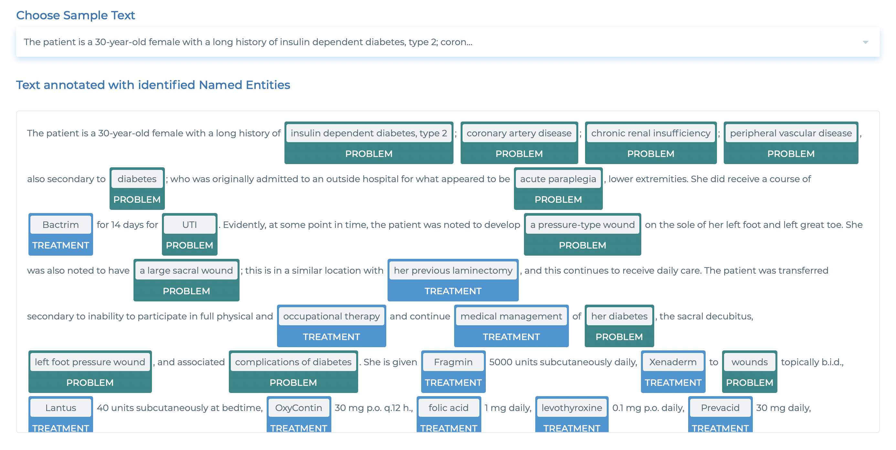
Same Idea (Med Concept Recognition), Newer Tech
https://demo.johnsnowlabs.com/healthcare/NER_CLINICAL/
Notes:
These are now deep learning based models – they’re better.
But the process ends up being the same
Comparison to extraction of features based on segmentation model, then simple model based on that

Slide 21
Conclusions
Bag of words techniques already go beyond the majority of “NLP” found in the medical literature
However, deep learning is rising in popularity. Much like in computer vision, we can now use transfer learning to adapt a pre-trained model to the problem at hand. It is best to start with a model pre-trained on a biomedical corpus.
Alternatively, we can take a more ad hoc approach: identify medical concepts with off the shelf deep learning tech, then build simple models on top of the identified medical concepts

